Slide 1
Cooking with AWS and Splunk
Module 13 : Best Practices for Data Collection
Kam Amir | Splunk Cloud Architect

Slide 2
Agenda
Planning your Data Collection Method
Hardware Requirements
Permissions
Scale
Cost Considerations
Multiple Account Data Collection
Project Trumpet Explained

Slide 3
Planning Data Collection
Hardware requirements

Slide 4
Hardware
Heavy Forwarder hardware requirements
Up to 20 AWS Accounts
All AWS Services
DOCS LINK
Minimum Hardware requirement : 4 vCPU, 4GB RAM
Recommended Hardware : 8-16 vCPU, 8-16GB RAM
Notes:
Collecting data from AWS can be done on a single Heavy Forwarder for AWS data sources.
As you in

Slide 5
Security : Permissions
Use EC2 Role for HF in your AWS environment
If using Access / Secret Keys make sure to rotate them on regular basis
Call out explicit resources in your AWS IAM Policy
Don’t use Resource : *
Use Resource : arn::s3::bucket_name

Slide 6
Scale : Data Collection
Single AWS Account – 1 HF with minimum / recommended hardware specs
< 20 AWS Accounts – 3 HF in a cluster with recommended hardware specs
Multiple HF’s in a cluster using SQS Based S3 for Config, CloudTrail
Dedicated HF’s for collection of CloudWatch Metrics, Description
Setup Lambda functions to send VPCFlow Logs into Splunk via HEC
20 + AWS Accounts
Configure CloudTrail, Config [GuardDuty], VPCFlow Logs to Kinesis Data Firehose
Use Trumpet to configure CloudFormation Template and distribute to multiple accounts

Slide 7
Push vs. Pull
Architecture and Best Practice

Slide 8
Getting Data In from AWS
Server vs. Serverless
Server (Pull)
Serverless (Push)
Legacy
Lambda
Kinesis Firehose
SQS Based S3
CloudTrail
Config
Description
CloudWatch (metrics)
CloudTrail
Config
Custom SQS
CloudWatch Logs
CloudWatch Events
S3 Access / ELB logs
CloudTrail
CloudWatch Logs
Kinesis Streams
Billing
S3 Access / ELB Logs

Slide 9

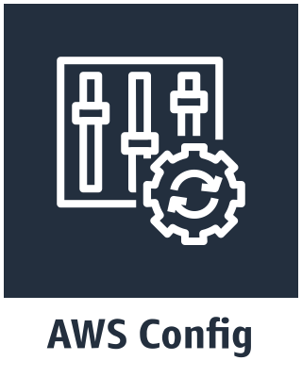
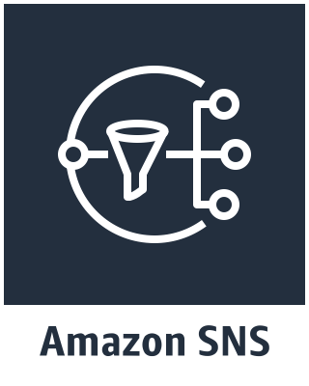
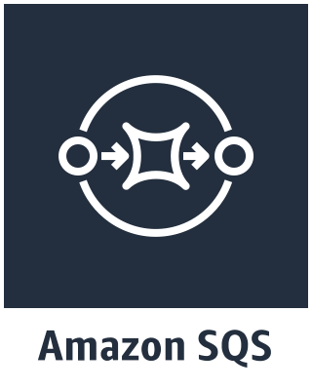

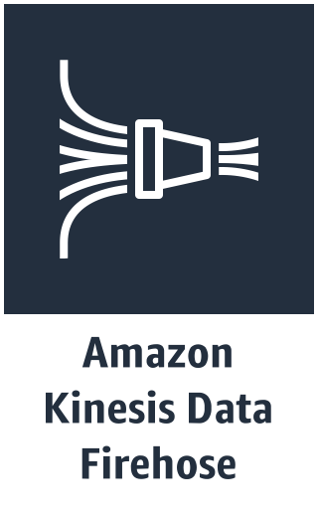

AWS Service Pull vs. Push
AWS Config and CloudTrail can be pulled with a Splunk Heavy Forwarder with the legacy modular input, SQS Based S3, Generic / Incremental S3. They can also be pushed with Kinesis Data Firehose through CloudWatch Events.
Pull
Push
HEC
SNS
Topic
Notification
SQS
Subscription
Notification
Event (event-based)
Splunk Pull
SQS Notification
Pulls Event from S3 Bucket
Config Events

Slide 10
The Case for Pull (Modular Input)
Modular inputs running on dedicated heavy forwarders
Pros:
Required for CloudWatch Metrics and Description input
Small deployment, validating data collection
Setup AWS to collet data and Splunk will
SQS Based S3 Inputs can be configured to be Highly Available
Cons:
Requires hardware
Higher cost for using CloudWatch Logs and running hardware
Legacy inputs not natively Highly Available (e.g. Description, CloudWatch metrics etc.)
Must setup and maintain permissions via policy

Slide 11
The Case for Push via Lambda Functions
Pros:
No hardware required for pushing data into Splunk via HEC
Built for high volume data sources
Setup only requires HEC URL and HEC Token
Quick way to ingest high volume data sources
Cons:
Does not work with two services / inputs Description and CloudWatch Metrics
Lambda functions do not have event acknowledgement
Cost if using CloudWatch Logs

Slide 12
The Case for Push via Kinesis Data Firehose
Pros:
No hardware required for pushing data into Splunk via HEC
Built for high volume data sources
Setup only requires HEC URL and HEC Token
Lower cost and less administration
Can be automated for many sub accounts
Kinesis Data Firehose validates events made it into Splunk
Cons:
Does not work with two services / inputs Description and CloudWatch Metrics
Potential learning curve to setup initial Kinesis Data Firehose
Region might not currently support Kinesis Data Firehose (e.g. GovCloud)
Must be high enough volume to fill data buffer

Slide 13
Cost Considerations
Push vs. Pull cost difference (Monthly on-Demand)
Push
Pull

Slide 14
Multi-Account Data Collection
AWS Specific method to collect from multiple accounts

Slide 15


Multiple Accounts : Loose Federation
Multiple Accounts within the same AWS Region
Setup Central Splunk Indexers in Master Account
Setup HF’s in each Sub Account to forward data into Master Account
Each Sub Account will use EC2 Policy
Forward Data over Internet or Private connection over TCP:9997 (SSL) and/or HEC
Lambda function for high volume data (e.g. VPCFlow)
AWS Master
AWS SubAccount
AWS SubAccount
AWS SubAccount
Notes:
This is geared to a company that just acquired a bunch of customers through an acquisition or a large group of independent developers who built out their own infrastructure in the cloud. This assumes no trust between Accounts.
Pros: Simply repoint existing HF’s to new Splunk indexers in central account
Cons : Cost of running and maintaining multiple heave forwarders
Requires AWS knowledge in each sub account to setup and configure services in AWS and how to collect that data with Splunk
Potential API rate limits

Slide 16
Multiple Accounts : Loose Federation
Detailed Setup
AWS Master
AWS SubAccount
HF:TCP:9997(SSL)
HEC:TCP:443 (SSL)
Central Splunk Indexers configured with Splunk Add-on for AWS and indexes.conf from Splunk App for AWS
HEC enabled on indexers to collect VPCFlow Logs from Lambda Functions
No indexer acknowledgement is needed for Lambda Functions
Heavy Forwarders (HF) configured with AWS EC2 Policy
Splunk Add-on for AWS installed on each HF
Lambda Function (splunk-cloudwatch-processing-log) enabled on AWS and sending VPCFlow data into Splunk via HEC
SQS Based S3 Modular input used for Config, CloudTrail and other S3 based logging (access logs, elb etc.)
Description and CloudWatch Metrics configured on HF using standard modular input
Notes:
This is geared to a company that just acquired a bunch of customers through an acquisition or a large group of independent developers who built out their own infrastructure in the cloud. This assumes no trust between Accounts.
Pros: Simply repoint existing HF’s to new Splunk indexers in central account
Cons : Cost of running and maintaining multiple heave forwarders
Requires AWS knowledge in each sub account to setup and configure services in AWS and how to collect that data with Splunk
Potential API rate limits

Slide 17

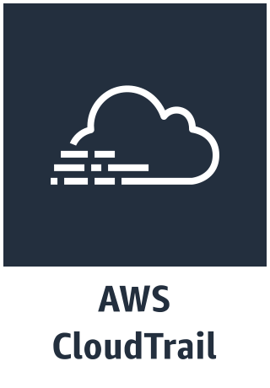
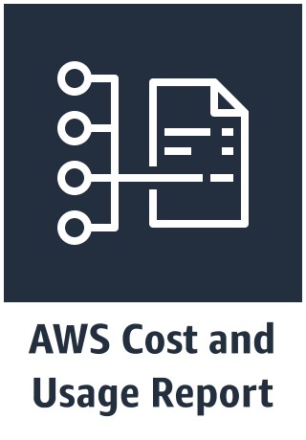

Multiple Accounts : Tight Federation (S3)
Multiple Accounts within the same AWS Region
Region
AWS Master
AWS SubAccount
Setup Central Splunk Indexers in Master Account
Each Sub Account writes to central S3 bucket
Assumes trust relationship between Accounts
Splunk Collects data from Central S3 bucket
Config Events
AWS SubAccount
AWS SubAccount
Notes:
This requires that there is some level of trust between the sub accounts and the master account.
Pros: One location for all data
Cons : Slow ingestion
Requires each sub account to have some level of AWS knowledge to setup services to send to central S3 bucket.
Complex S3 permissions to allow write from multiple accounts

Slide 18
Multiple Accounts : Tight Federation (S3)
Detailed Setup
AWS Master
AWS SubAccount
TCP:443:SSL
S3 Events
Splunk Indexers pull from central S3 bucket
S3 Bucket managed and configured by central admins granting permissions for each sub account to write into S3 bucket
SQS Based S3 input leveraged to collect data out of S3 buckets
If KMS key used for encryption, must share key with Sub Accounts
AWS Sub Account writes all data to central S3 bucket
AWS Admin configures services to write to central S3 bucket
No Splunk HF’s deployed in sub account
Coordinate sending data into Master Account, validate data landing in proper S3 bucket and subfolder
Notes:
This is geared to a company that just acquired a bunch of customers through an acquisition or a large group of independent developers who built out their own infrastructure in the cloud. This assumes no trust between Accounts.
Pros: Simply repoint existing HF’s to new Splunk indexers in central account
Cons : Cost of running and maintaining multiple heave forwarders
Requires AWS knowledge in each sub account to setup and configure services in AWS and how to collect that data with Splunk
Potential API rate limits

Slide 19
Multiple Accounts : Tight Federation (HF)
Multiple Accounts within the same AWS Region
Region
AWS Master
AWS SubAccount
Setup Central Splunk Indexers in Master Account
Each Sub Account is managed by the Master account
Assumes trust relationship between Master and Sub Accounts
Splunk AssumesRole into each Account to collect data
AWS SubAccount
AWS SubAccount
Notes:
This requires that there is some level of trust between the sub accounts and the master account.
Pros: One location for all data
Cons : Slow ingestion
Requires each sub account to have some level of AWS knowledge to setup services to send to central S3 bucket.
Complex S3 permissions to allow write from multiple accounts

Slide 20
Multiple Accounts : Tight Federation (HF)
Detailed Setup
AWS Master
AWS SubAccount
HF:TCP:9997(SSL)
HEC:TCP:443 (SSL)
Master account pulls data from Sub Accounts
Heavy Forwarders (HF) configured with trusted IAM Role to pull data from sub accounts
Maintain HF’s for each sub account
Configure AWS Services to collect data
Establish trust relationship with AWS Master Account
Notes:
This is geared to a company that just acquired a bunch of customers through an acquisition or a large group of independent developers who built out their own infrastructure in the cloud. This assumes no trust between Accounts.
Pros: Simply repoint existing HF’s to new Splunk indexers in central account
Cons : Cost of running and maintaining multiple heave forwarders
Requires AWS knowledge in each sub account to setup and configure services in AWS and how to collect that data with Splunk
Potential API rate limits

Slide 21
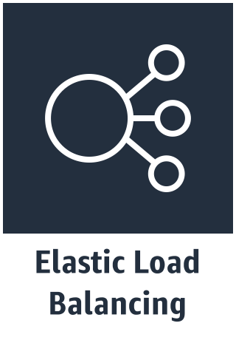
Multiple Accounts : Alliance
Multiple Accounts within the same AWS Region
Region
AWS Master
AWS SubAccount
Setup Central Splunk Indexers in Master Account
Sub Accounts configured to send all data through Kinesis Firehose into Master Account
Data is sent via Http Event Collector (HEC) TCP:443 and load balanced within the master account
Configurations deployed by Master Account Admins
AWS SubAccount
AWS SubAccount
Notes:
This does not require a trust between the sub accounts and the master account. The data can be configured to send through the Kinesis Data Firehose by each Sub Account, or with the help of the Master Account.
Pros: Cost is lower with KDF
Data sent serverlessly
Configuration done by master account team and easily distributed to sub accounts, not requiring AWS expertise at the sub account level.
Cons : Possible slow ingestion of data due to requirements for Kinesis Data Firehose buffer

Slide 22
Multiple Accounts : Alliance
Detailed Setup
AWS Master
AWS SubAccount
HF:TCP:9997(SSL)
HEC:TCP:443 (SSL)
Splunk Indexers must have Splunk Add-on for AWS, Splunk Add-on for Kinesis Firehose and indexes.conf from Splunk App for AWS
Public Facing VIP / ELB with valid SSL Cert
Splunk v.6.6+ (See config for inputs.conf)
Enable Indexer ACK on HEC
Create and distribute CloudFormation template for configuring AWS sub account
Sub Account configured by CloudFormation template created by administrators in Master Account
High volume data sent via Kinesis Data Firehose (e.g. VPCFlow, CloudTrail, Config etc.)
Description and CloudWatch metrics sent using modular inputs on Heavy Forwarder
HF uses EC2 IAM Role
Notes:
This is geared to a company that just acquired a bunch of customers through an acquisition or a large group of independent developers who built out their own infrastructure in the cloud. This assumes no trust between Accounts.
Pros: Simply repoint existing HF’s to new Splunk indexers in central account
Cons : Cost of running and maintaining multiple heave forwarders
Requires AWS knowledge in each sub account to setup and configure services in AWS and how to collect that data with Splunk
Potential API rate limits

Slide 23

Organization
AWS Logging (Splunk Cloud)
Organization
Logging Account
Security Account
Master Account
Sub Accounts
Trust
Trust
Trust
AssumeRole
AssumeRole
AssumeRole
AWS Master
AWS Security
AWS Sub
Create policy and distribute to accounts using service catalog.
Trust the Logging Account to pull data from local services (Description, Inspector, CloudWatch Metrics.)
Trust the Logging Account to pull data from local services (Description, Inspector, CloudWatch Metrics.)
S3 Bucket with all data for backup.

Slide 24
Organization
AWS Logging (Splunk Cloud)
Organization
Logging Account
Security Account
Master Account
Sub Accounts
AssumeRole
AssumeRole
AssumeRole
AWS Master
AWS Security
AWS Sub

Slide 25
Great, now what should I use?
Best practice for GDI from your cloud deployment

Slide 26
Chose your adventure
Help determine what path you should use for your data collection
Criteria | Competency | Recommended Method | Example
Less than 20 AWS Accounts, low growth of AWS Accounts. | Low AWS / Splunk knowledge | Loose Federation | Company acquires new company with many AWS Accounts.
Up to 20 AWS Accounts, event latency tolerable | Moderate AWS / Splunk knowledge | Tight Federation (S3) | Sub Account AWS Admins can send data into Central S3
Up to 20 AWS Accounts, event latency must be within 20 minutes | Moderate AWS / Low Splunk knowledge | Tight Federation (HF) | Sub Accounts have no HF’s deployed and trust master account
More than 20 AWS Accounts and event latency must be within 5 minutes or less | High AWS / Moderate Splunk knowledge | Alliance | Master Account has KDF setup and Sub Accounts can deploy CloudFormation Templates

Slide 27
Project Trumpet Explained

Slide 28
Project Trumpet
Automating Data Collection from AWS into Splunk via Kinesis Data Firehose
Splunk Blog Project Trumpet
GitHub Repo
Initial CloudFormation template created to Setup AWS account
Generate CloudFormation Template

Slide 29
Thanks

